Slide 1
What are they communicating?

Slide 2


Slide 3
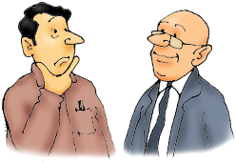

Slide 4
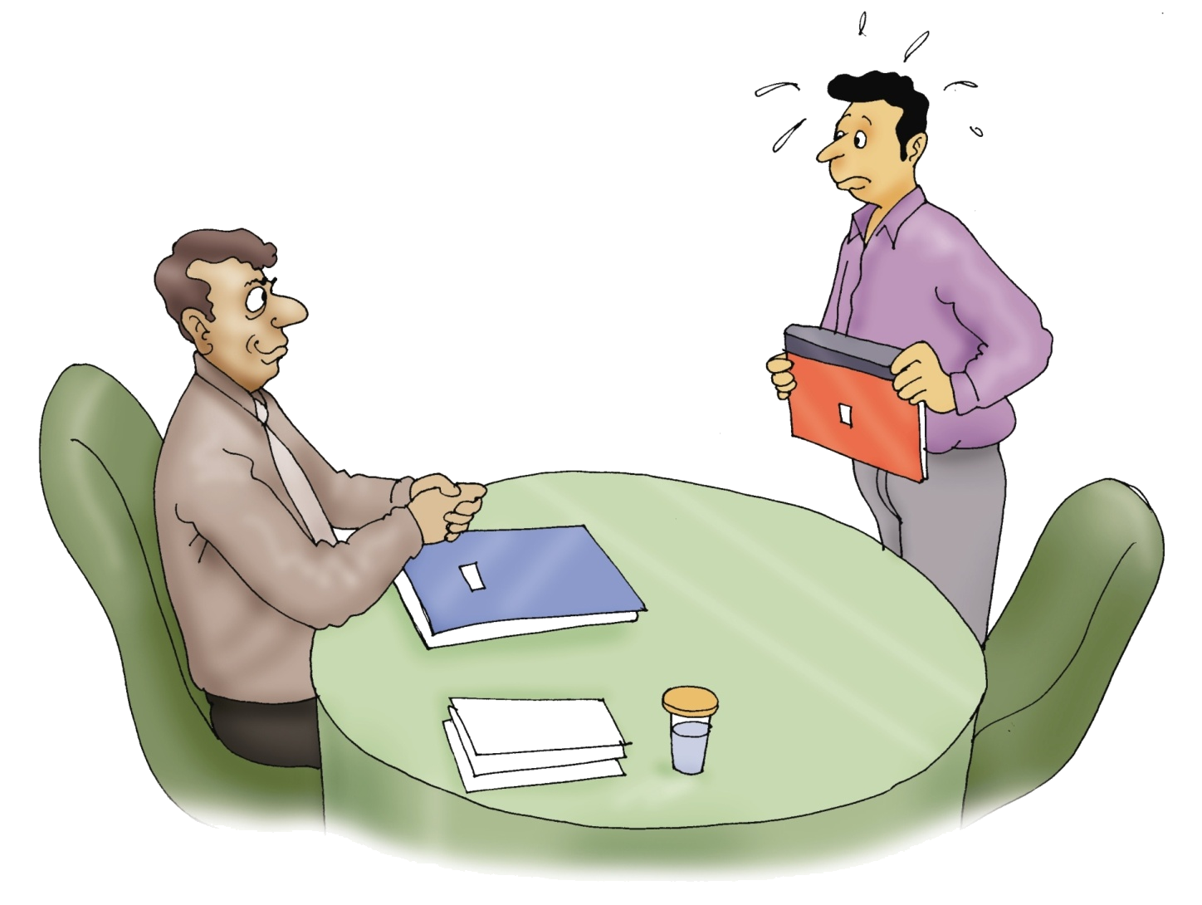

Slide 5

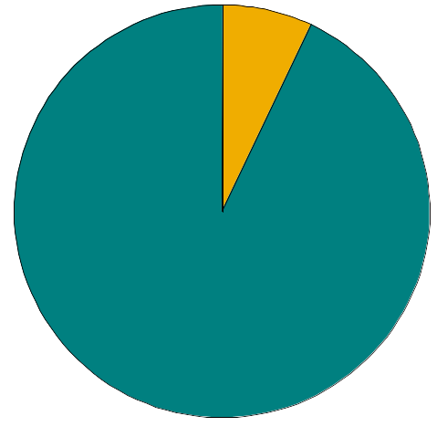
93%
Non-Verbal Communication
Without Words
7%
Verbal Communication
With Words
Notes:
Use slides to show verbal & non-verbal communication
Only 7% of what we tell somebody is through our words….. The rest is through non-verbal communication ---

Slide 6

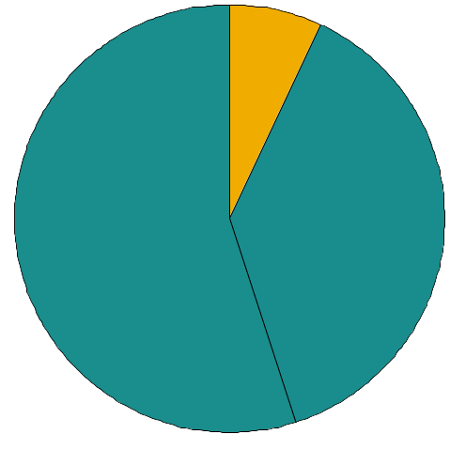
7%
Verbal Communication
With Words
Grooming
Etiquettes
Facial Expressions
Hand Gestures
Body Posture
Physical Distance
Happiness
Enthusiasm
Frustration
Anger
Sadness
Fear
Secrecy
7%
55%
Body language
38%
Voice
Volume
Speed
Tone
Pitch
Modulation
Notes:
Out of 97% non-verbal…..38% is due to our voice quality…..

Slide 7


  • Personal appearance
  • Greeting or handshake
  • Grooming
  • Eye contact
  • What & how you speak
  • Confidence
  • Overall personality
  • Attitude
  There is no second chance to make
  a first impression!

Slide 8


• Eye Contact
• Smile
• Facial Expressions
• Hand Gestures
• Handshakes
• Body Postures
• Voice Modulations

Slide 9

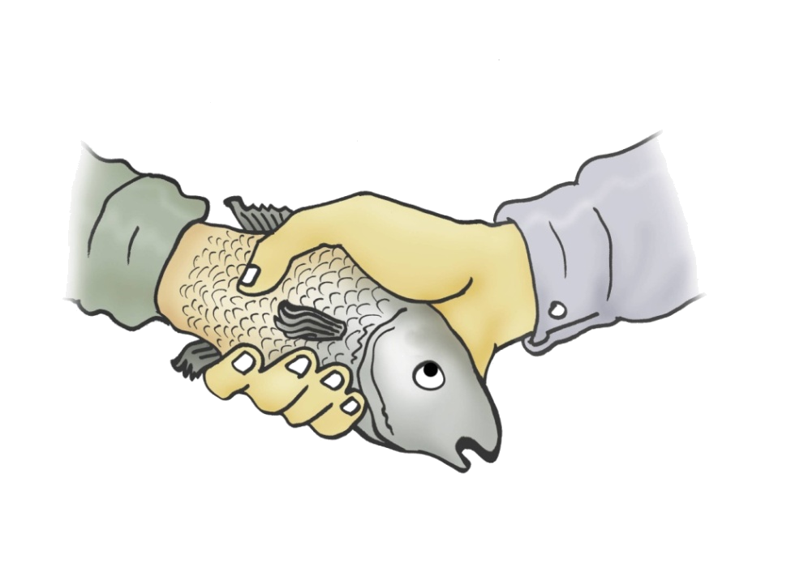

Dead Fish
Squeeze/ Knuckle Crunch
Indicates lack of
confidence
Indicates aggression or
power

Slide 10
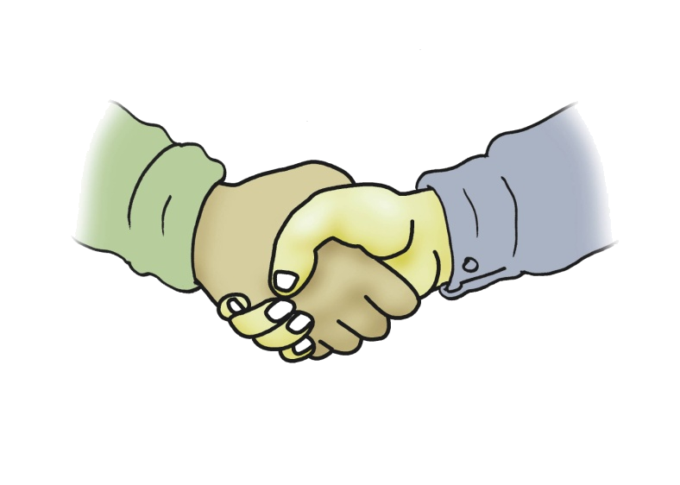
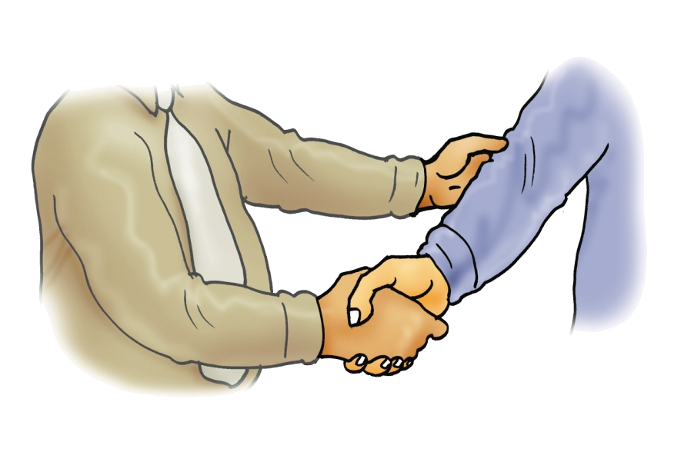
Firm
Elbow grasp
Indicates bonding
Indicates trust and
reassurance

Slide 11

Sandwiched
Indicates trust and concern

Slide 12

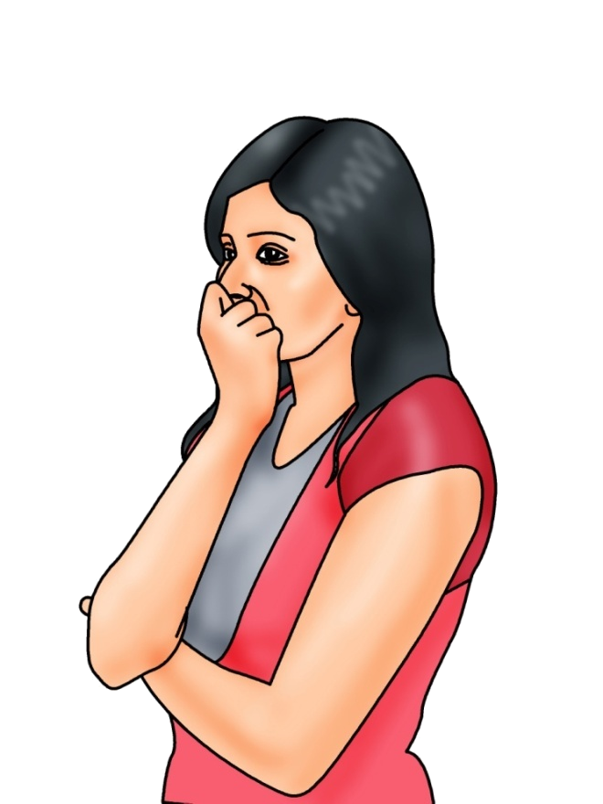
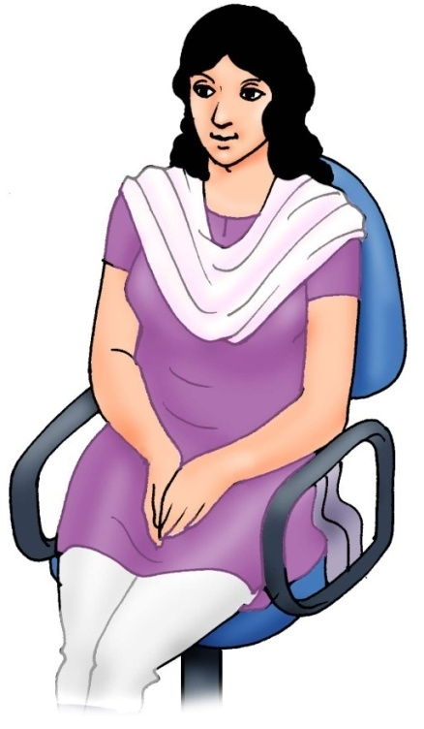
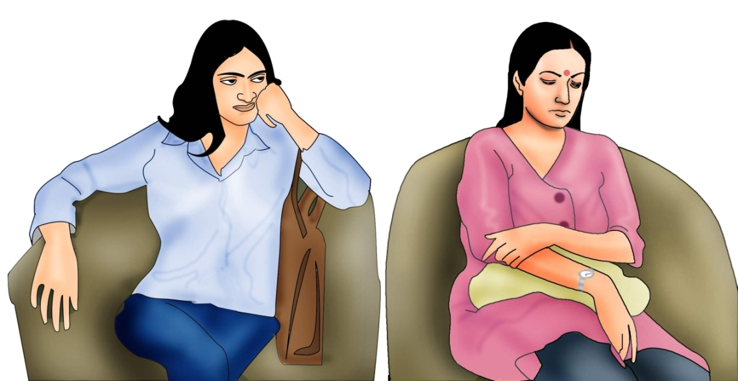
Stress, anxiety
Listening with attention
Not interested

Slide 13
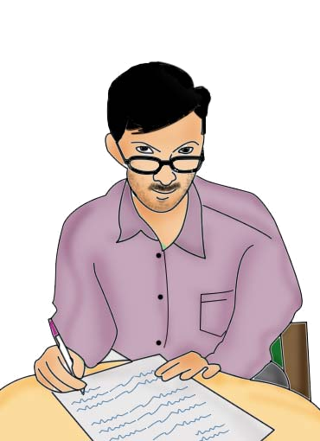
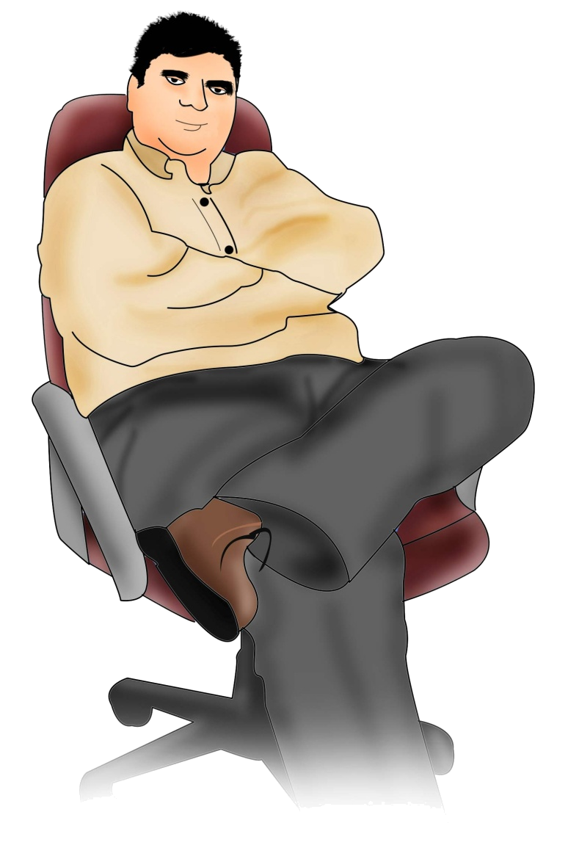
I’M THE BOSS!
I have other things to do!
A superior and arrogant attitude
Do not disturb – I do not have time for you!!

